Slide 1
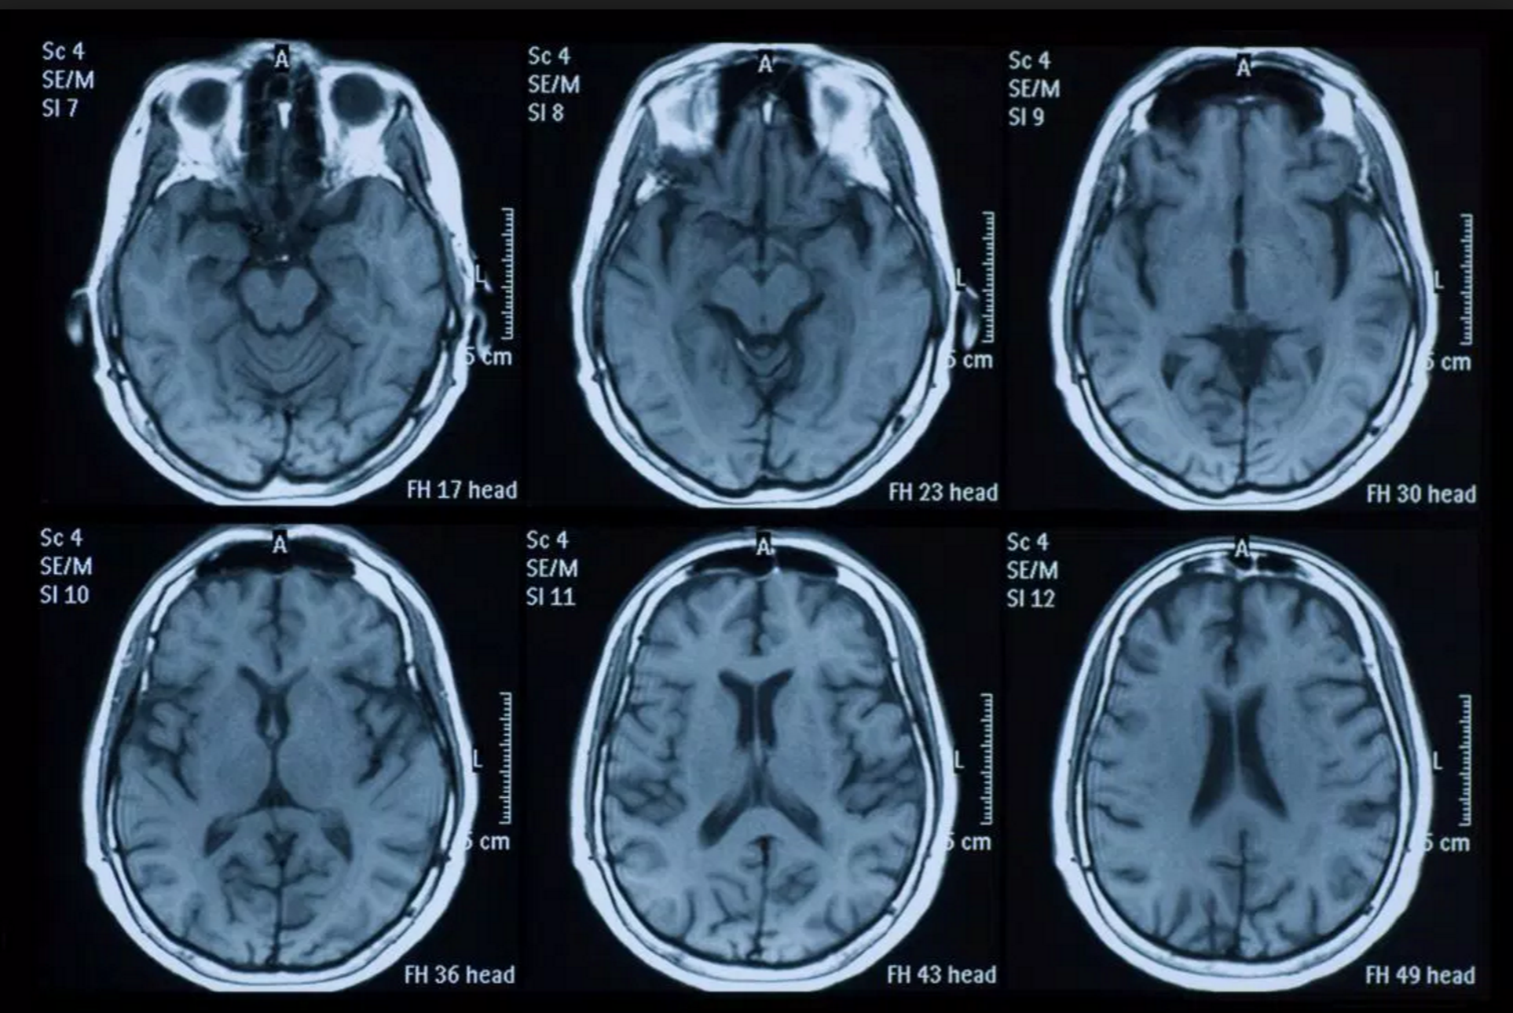
An Automated and Intelligent Medical Decision Support System for Brain MRI Scans Classification
Muhammad Faisal Siddiqui, Ahmed Wasif Reza, Jeevan Kanesan
August 17, 2015
Public Library of Science – DOI:10.137
Presented by: Cole MacLean

Slide 2
Problem Definition
Problem Statement
Diagnosis from brain imaging scans such as MRIs require specialized and time consuming analysis from doctors
Develop system to automatically classify normal/abnormal brain from MRI imaging
Data Sources
Harvard Medical School – http://med.Harvard.edu/AANLB/ - 255 MRIs
Open Access Series of Imaging Studies (OASIS) - http://www.oasis-brains.org/ - 340 MRIs
Goal
Given an MRI image, determine if the brain should be classified as normal or abnormal

Slide 3
Problem Definition - Scope
Dataset Group | Dataset Classifications (Normal/Abnormal) | Benchmark Classified Brain Diseases
Group-1 HMS: 11 Diseases | 235/220 | glioma, sarcoma, Alzheimer’s disease, Alzheimer’s disease with visual agnosia, Pick’s disease, Huntington’s disease, meningioma, chronic subdurnal hematoma, multiple sclerosis, cerebral toxoplasmosis, and herpes encephalitis
Group-2 OASIS: 24 Diseases | 80/260 | Group-1 Plus: metastatic bronchogenic carcinoma, metastatic adenocarcinoma, motor neuron disease, cerebral calcinosis, AIDS dementia, Lyme encephalopathy, Creutzfeld-Jakob disease, hypertensive encephalopathy, multiple embolic infarctions, cerebral haemorrhage, cavernous angioma, vascular dementia, and fatal stroke

Slide 4
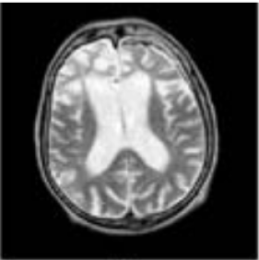
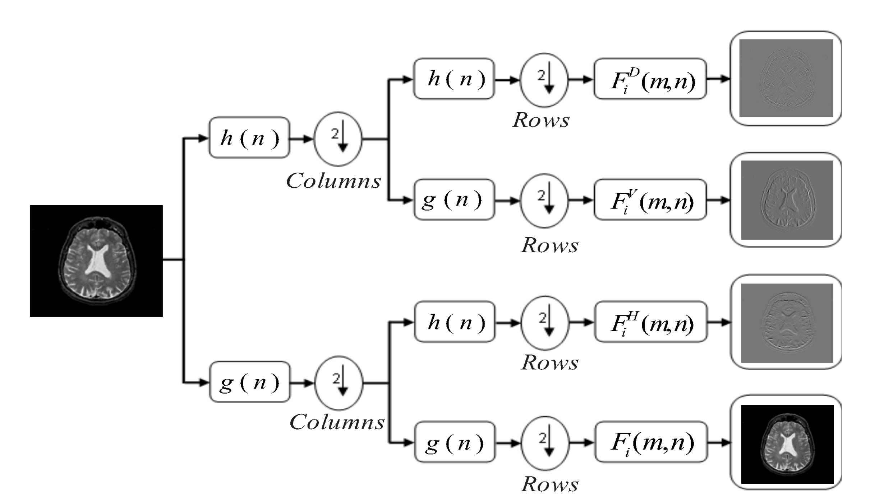
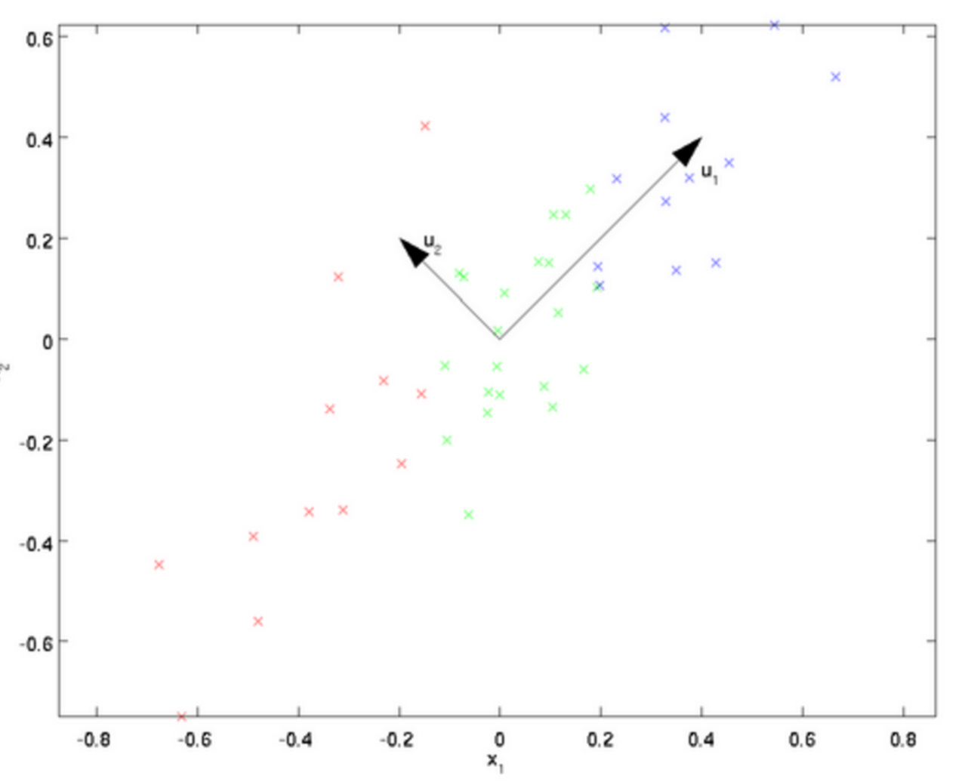
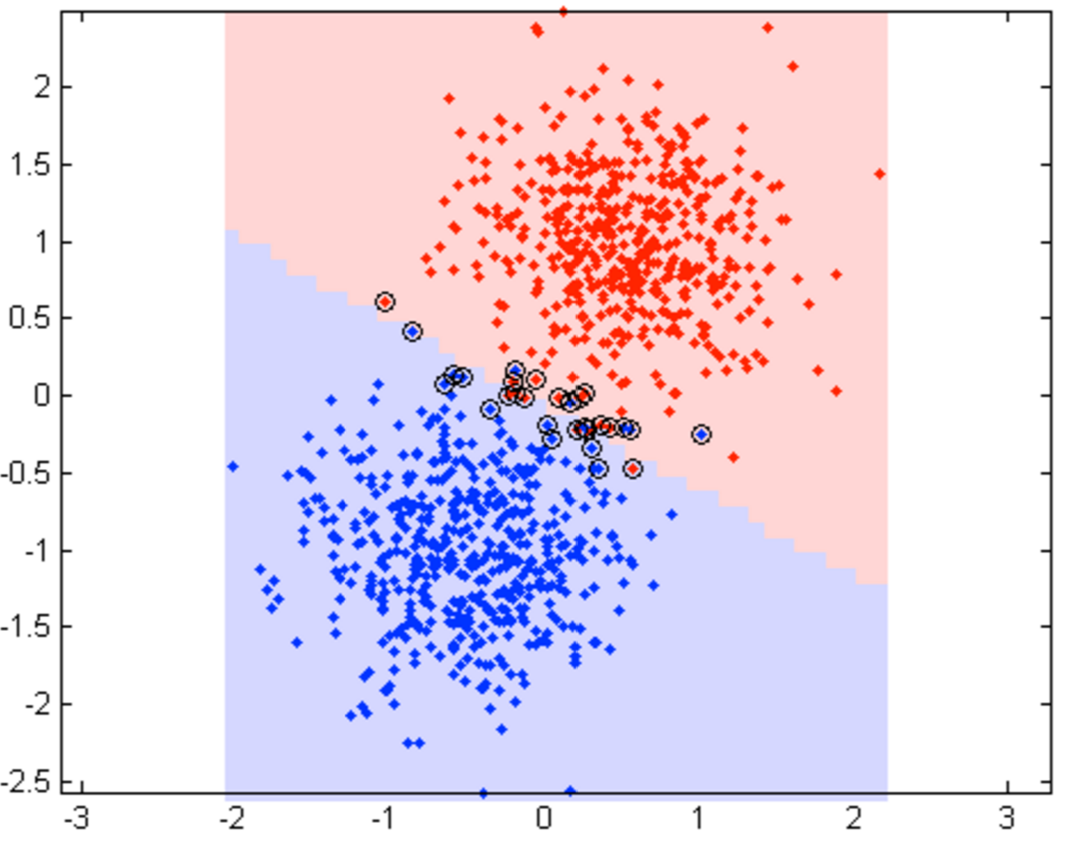
Group-1 MRI Images
Group-2 MRI Images
Feature Extraction
2D-DWT
Feature Reduction
PCA 8 Features
LS-SVM
Model Development
Hyper-parameter optimization
5-Fold CV

Slide 5
IDSS Techniques Used
2D – Fast Discrete Wavelet Transformation
Principle Component Analysis
Least Squares Support Vector Machine
K-Fold Cross-validation Hyper-parameter Optimization

Slide 6
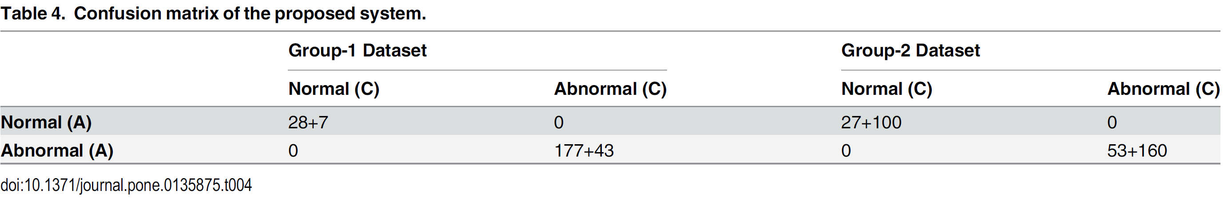
Final Results and Future Work
Results
Future Work
Classification of specific brain disease
Other body part MRI scan classification
Further validation on broader datasets

